Slide 1

Practical Consideration of SAFETY

Slide 2
Safety Logic
What will happen if a person is caught in a drive mechanism?
Immediately STOP the system!
How do you STOP? Emergency Stop button?
When the motor operates in overload condition, how to cut off before it gets damaged / electrical fires?
Safety is the most important factor to incorporate to the mechanical design, circuit design and the programming of PLC.
Fatalities or serious injuries could be avoided when safety is incorporated.

Slide 3
Learning Outcome
Implement safety logic including interlock and overload to electrical circuit
Explain the function of master control relay, safety PLC and safety system
Design control circuits interfacing to PLC

Slide 4
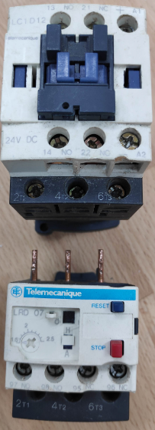
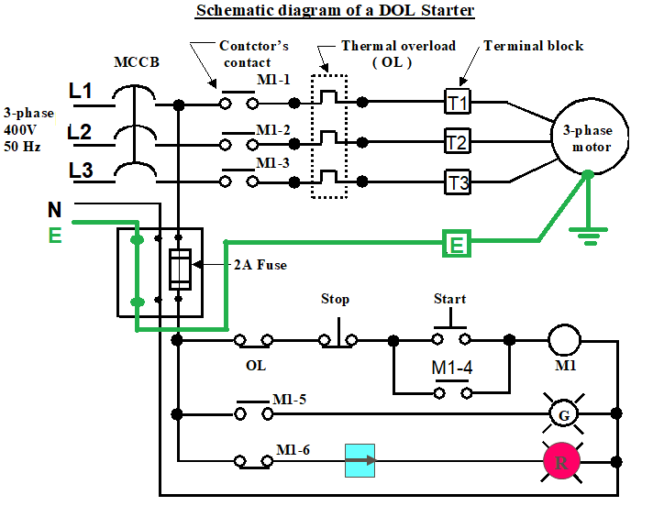
Typical Motor Starter Circuit
Reset
Stop
Power Circuit
Trip
setting
Contactor
Thermal Overload
Contactor – Electromechanical device used for switching on/off large current load such as motors. Controlled by small current to electromagnet.
Thermal overload device protects circuit by opening the contact when the current is higher than setting. Typically needs to be manually reset before restarting circuit.
Notes:
A Direct Online (DOL) motor starter circuit would comprise of power and control circuit. The control circuit could be replaced by PLC to control multiple motors. But OL status is still required to input to PLC to stop the control circuit.
Let’s take this example.

Slide 5
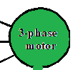


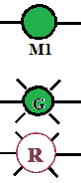
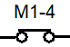
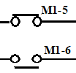
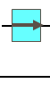
Typical Motor Starter Circuit
Power Circuit
Control Circuit
Contactor
Thermal Overload
Notes:
A Direct Online (DOL) motor starter circuit would comprise of power and control circuit. The control circuit could be replaced by PLC to control multiple motors. But OL status is still required to input to PLC to stop the control circuit.
Let’s take this example.

Slide 6

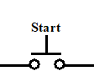
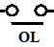
Typical Motor Starter Circuit
Power Circuit
Control Circuit
Contactor
Thermal Overload
Notes:
When OL is activated, it will open the power circuit to the motor, at the same time, aux contact will open, de-energizing the contactor M1 Coil.
IF the OL contact is not present, what will happen???
M1 contacts will still be close, and once OL condition is over, the motor will run immediately without pressing start button. Posing a risk to any personnel or system.

Slide 7
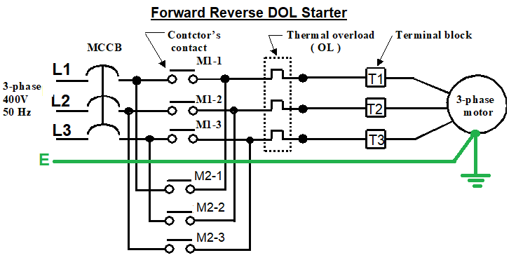
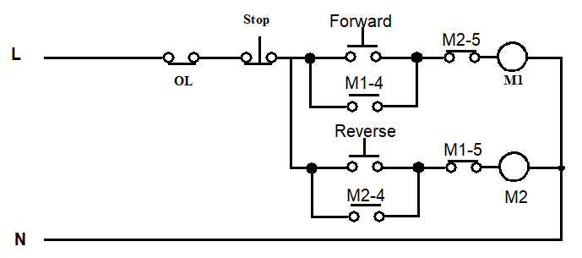
Forward Reverse Motor with Interlock
Interlock
Notes:
Reverse the 3-phase induction motor, reverse the L2 and L3 would change the phase sequence.
The safety consideration is to add an INTERLOCK. To ensure during forward, reverse contactor will not energize.
As it would result in line to line short circuit.

Slide 8
Interlocking
Interlock is to ensure mutually exclusive functionality for safe operation.
Forward and Reverse is not allowed to exist at the same time, hence interlocking is used.
Where else would you use interlock?
Elevator interlock vertical movement with open door / opening door when elevator is moving
Interlocking 2 doors in clean room

Slide 9
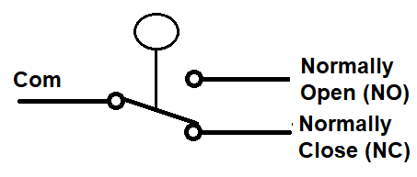
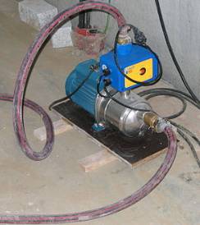
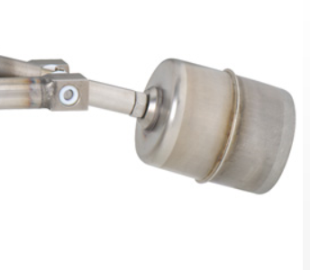
Normally Open or Normally Close
Water Inlet
High Level Switch
Electric Pump
Water is pumped into the tank, in order to cut off the pump, the float switch would sense that water is high level.
NC is normally used instead of NO.
In the event of any failure of the switch, the NC contact would open and stop the pump.
Similar reason why stop & E-stop buttons should be wired with NC contact

Slide 10
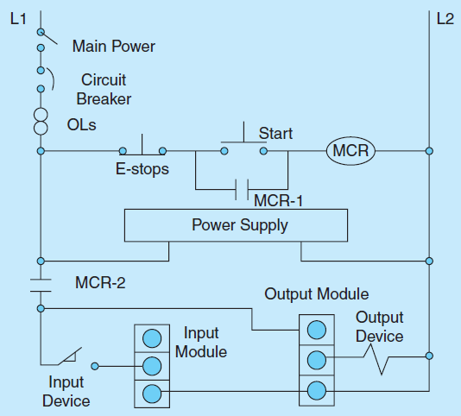
Master Control Relay (MCR)
Used as a standard hardware safety technique protecting the system under emergency condition
Example: MCR provides power to the I/O modules
Hence when MCR is not operating, there is no power to I/O

Slide 11
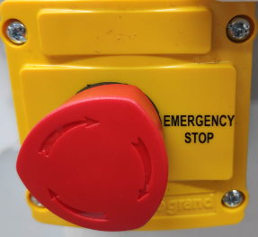
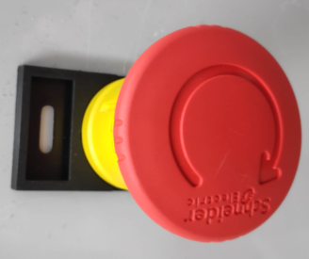
Emergency Shutdown (ESD)
Emergency Stop button (NC contact)
Latches on upon activation.
Turn the knob release the button.
Activation of ESD stops all outputs during emergency.
The connection would be similar to MCR, except that it cuts off only output module.
Activation of ESD could also be programmed to perform a shut down sequence to return process to safe state

Slide 12

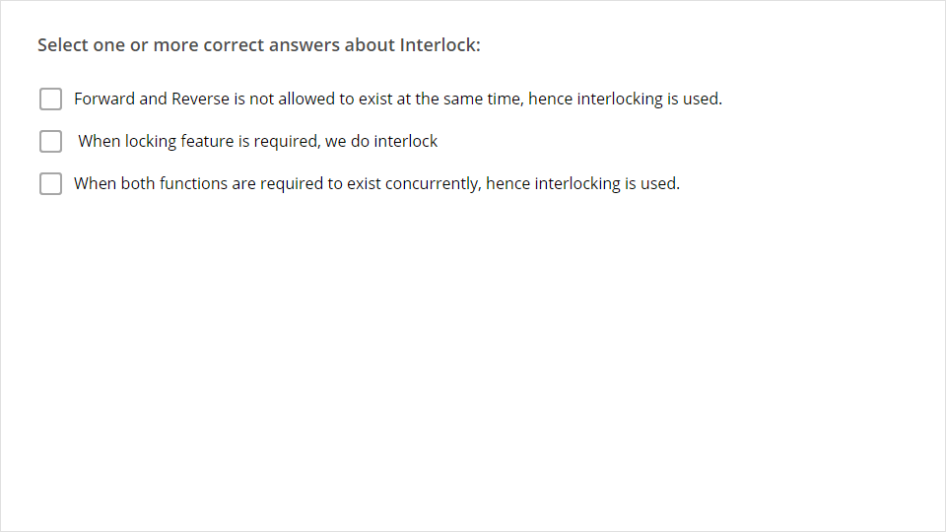
Quiz
Click the Quiz button to edit this object

